Slide 1

We will get started shortly.
International Science Nutrition Society – CURARE CAUSAM - ISNS 2023

Slide 2

ISNS CASE STUDY
With Dr. Norbert Ketskes on Colon Cancer
International Science Nutrition Society – CURARE CAUSAM - ISNS 2023

Slide 3
Medical Disclaimer
The information provided is for educational purposes and is not intended as medical advice, or a substitute for the medical advice of a physician or other qualified health care professional. This is for science and educational purposes only and cannot be used in any aspect for sales or marketing. You should not use this information for diagnosing a health or fitness problem or disease. You should always consult with a doctor or other health care professional for medical advice or information about diagnosis and treatment. This is Confidential. Do not distribute—for scientific educational purposes only.
International Science Nutrition Society – CURARE CAUSAM - ISNS 2023

Slide 4
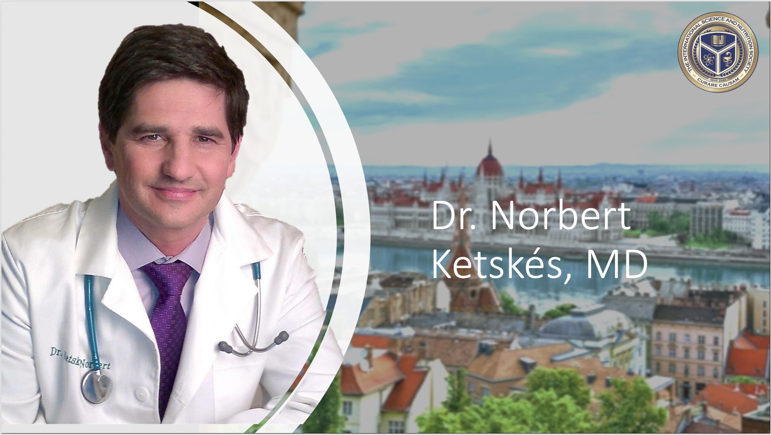

Slide 5
DR. NORBERT KETSKÉS, MD
Dr. Norbert Ketskés M.D. is one the most acknowledged gastroenterologists in Hungary, specializing in natural and organic nutritional solutions, leading the well-known Primus Labor, a private clinic offering personalized nutritional advice to its patients.
Scientific Adviser of ISNS
Independent Scientific Adviser of Rain International in Europe since 2013
Medical Partner of the Hungarian Olympic Committee since 2015
Member of the Medical Board of Hungarian Karate Association since 2015
Leader of the Primus Labor Private Medical Clinic since 2013
Working as a Family Doctor 1999 – 2012
International Science Nutrition Society – CURARE CAUSAM - ISNS 2023

Slide 6
CSISZTU ZSUZSA
Television - Presenter, Anchor, Editor, Journalist and Sports Lawyer, Sport-diplomat
Spokesperson of the Giro d’Italia Grande Partenza, (Road-Cycling World -Tour Championship)
Spokesperson of the FINA (Swimming and Waters poets World Championship)
2022 Vice-President of the Hungarian Sports Journalists’ Association
Member of the Hungarian Olympic Committee Member of the Advisory Board of the Hungarian Olympic Academy
Newly Elected Vice-President of the International Sports Journalists Association, the first female ever in the field from her homeland, and third globally since 1924 (AIPS)
International Science Nutrition Society – CURARE CAUSAM - ISNS 2023

Slide 7
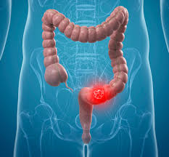
What is Colon Cancer?
Colon cancer is a growth of cells that begins in a part of the large intestine called the colon. The colon is the first and longest part of the large intestine. The large intestine is the last part of the digestive system. The digestive system breaks down food for the body to use.
Colon cancer is currently the third most common cancer in both men and women. In 2023, The American Cancer Society estimates that there will be approximately 153,020 new cases diagnosed and 52,550 deaths due to colon cancer in the United States.
International Science Nutrition Society – CURARE CAUSAM - ISNS 2023

Slide 8
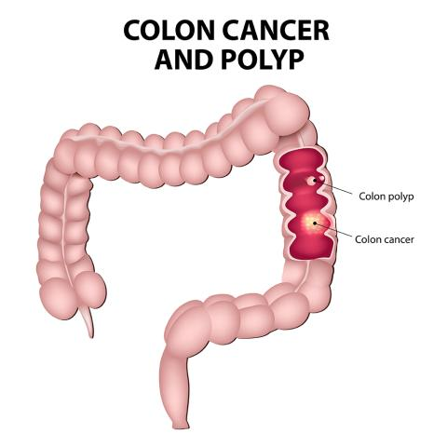
Colon Cancer
Colon cancer typically affects older adults, though it can happen at any age. It usually begins as small clumps of cells called polyps that form inside the colon. Polyps generally are not cancerous, but some can turn into colon cancers over time.
Polyps often do not cause symptoms. For this reason, doctors recommend regular screening tests to look for polyps in the colon. Finding and removing polyps helps to prevent colon cancer.
International Science Nutrition Society – CURARE CAUSAM - ISNS 2023

Slide 9
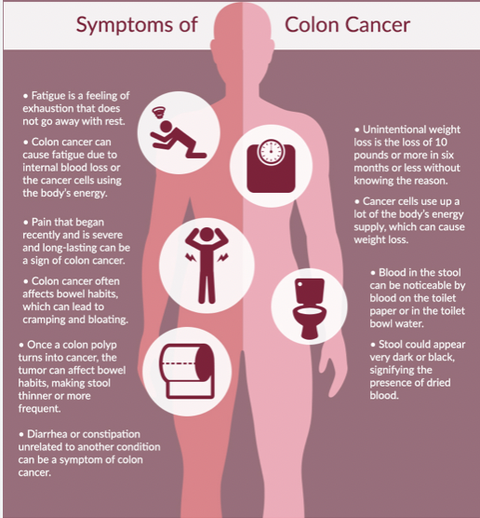
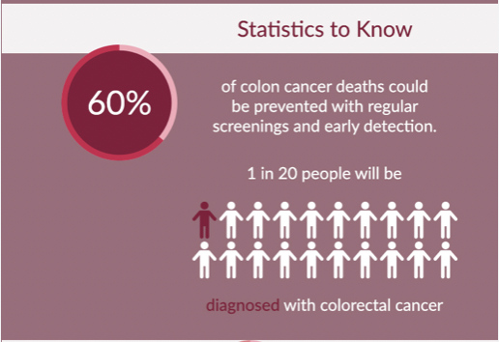
Symptoms
Colorectal cancer symptoms depend on the size and location of the cancer. Some commonly experienced symptoms include changes in bowel habits, changes in stool consistency, blood in the stool, and abdominal discomfort
International Science Nutrition Society – CURARE CAUSAM - ISNS 2023

Slide 10
Causes of Colon Cancer
Doctors are not certain what causes most colon cancers.
Colon cancer happens when cells in the colon develop changes in their DNA. A cell’s DNA holds the instructions that tell the cells what to do. The changes tell the cells to multiply quickly. The changes let the cells continue living when healthy cells die as part of their natural lifecycle.
This causes too many cells. The cells might form a mass called a tumor. The cells can invade and destroy healthy body tissue. In time, the cells can break away and spread to other parts of the body. When cancer spreads, it is called metastatic cancer.
International Science Nutrition Society – CURARE CAUSAM - ISNS 2023

Slide 11
Risk Factors of Colon Cancer
Older Age
Personal History of Colorectal Cancer or Polyps
Inflammatory Bowel Diseases
Inherited Syndromes
Family History of Colon Cancer
Not Exercising Regularly
Diabetes
Smoking
Eating habits
International Science Nutrition Society – CURARE CAUSAM - ISNS 2023

Slide 12
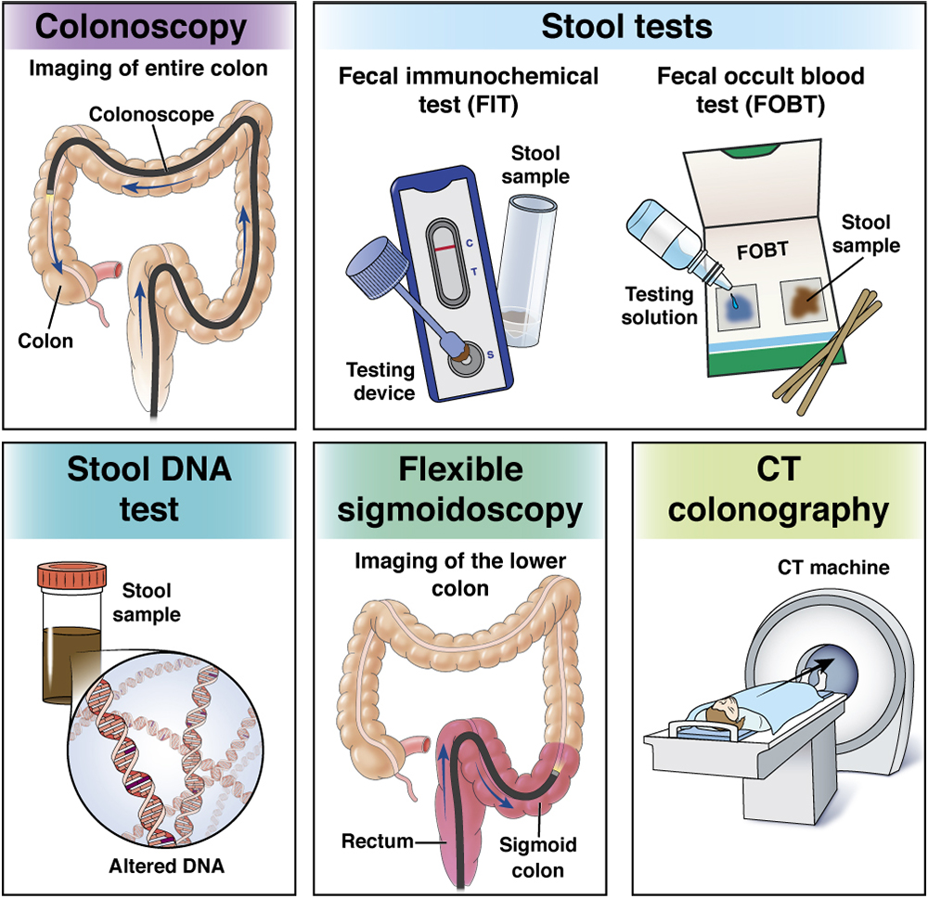
Prevention
Doctors recommend that people with an average risk of colon cancer consider starting colon screening around age 45. People with an increased risk should think about starting screening sooner. People with an increased risk include those with a family history of colon cancer.
There are several different tests that are used for colon cancer screening. Talk about your options with your healthcare team.
International Science Nutrition Society – CURARE CAUSAM - ISNS 2023

Slide 13
Lifestyle Changes to Reduce the Risk of Colon Cancer
Eat a Variety of Fruits, Vegetables, and Whole Grains - which contain vitamins, minerals, fiber, and antioxidants, which may help prevent cancer.
What not to eat!!
Drink Alcohol in Moderation, If at All – If you choose to drink, limit the amount you drink to no more than one drink a day for women and two for men.
Stop Smoking – Talk to your healthcare team about ways to quit.
Exercise Most Days of the Week – Try to get in at least 30 minutes of exercise on most days. If you have been inactive, start slow and build up gradually to 30 minutes.
Maintain a Healthy Weight – If you are at a healthy weight, work to maintain it by combining a healthy diet with daily exercise. If you need to lose weight, ask your healthcare team about healthy ways to achieve your goal.
International Science Nutrition Society – CURARE CAUSAM - ISNS 2023

Slide 14
CASE STUDY
Patient: Male
Age: 58 year old
Family history:
He has a history of hypertension, which is well-controlled with medications.
He has a history of smoking for 30 years and a family history of colon cancer.
He complains of abdominal pain, changes in bowel habits (diarrhea and constipation), and rectal bleeding over the past three months. He also reports fatigue and unexplained weight loss of 10 kilograms over the last four months.
Colonoscopy: This shows a large, obstructing mass in the sigmoid colon. Biopsies are taken.
Biopsy: Histopathological analysis of the biopsy confirms the presence of adenocarcinoma in the sigmoid colon.
Diagnosis: Stage II colon carcinoma, specifically adenocarcinoma of the sigmoid colon. The cancerous growth has not yet invaded nearby lymph nodes or distant organs.
International Science Nutrition Society – CURARE CAUSAM - ISNS 2023

Slide 15
CASE STUDY
We met for the first time after 8 chemotherapy treatments. Then the following complaints appeared as side effects of the treatment:
general weakness, diarrhea, nausea, vomiting, malaise,
Lab tests:
Mild anemia (low hemoglobin and hematocrit levels).
Haemoglobin: 92 (range 120-160 g/l)
Haematocrit: 0,25 (range 0,36-0,47 l/l)
High inflammatory parameter:
Higher WBC (white blood cells): 15,2 (range 4,8-10,8 G/L) CRP: 75 mg/l, (range 0- 5,0)
Higher liver enzyme levels: ASAT:97(U/L) (range 0-50), ALAT:96 (U/L) (range 0-50), GGTP: 100 (range 8-50 U/l)
International Science Nutrition Society – CURARE CAUSAM - ISNS 2023

Slide 16
Conventional Treatment
Treatment for colon cancer is based largely on the stage (extent) of the cancer, but other factors can also be important. People with colon cancers that have not spread to distant sites usually have surgery as the main or first treatment. Chemotherapy may also be used after surgery (called adjuvant treatment). Most adjuvant treatment is given for about 6 months.
International Science Nutrition Society – CURARE CAUSAM - ISNS 2023

Slide 17
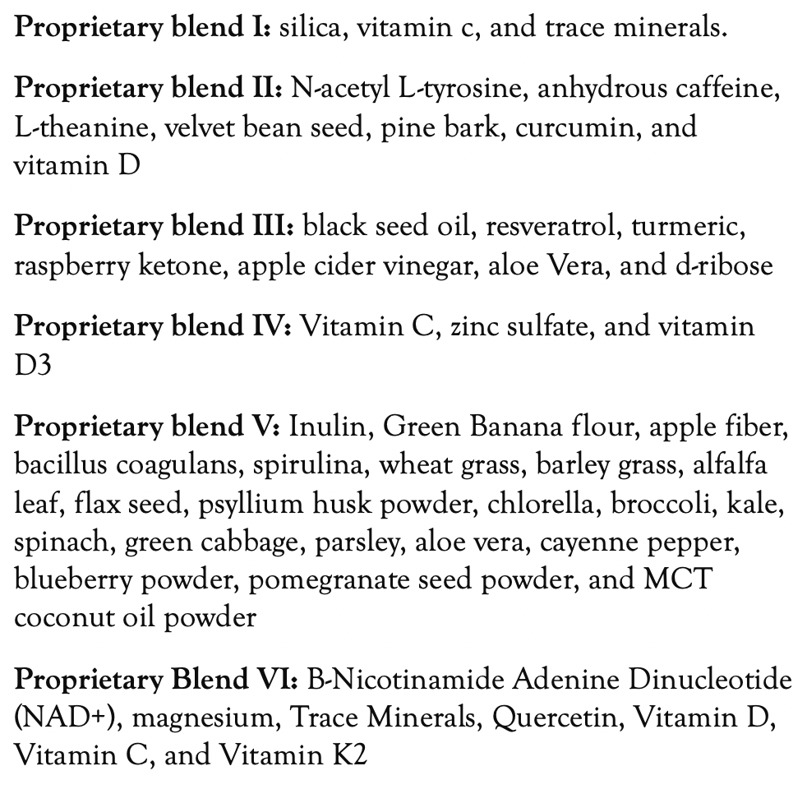
Method
PROPRIETARY BLENDS LEGEND
Proprietary blend I: 2x8 drops, morning and evening, for 3 days, then every 3 days then increased by 1-1 drops every 3 days to 2x10
Proprietary blend II: 1 in the morning for 7 days, then 2, 1 in the morning and 1 in the afternoon,
Proprietary blend III:1 sachet in the morning for 7 days then 1 sachet in the morning and 1 sachet in the evening
Proprietary blend IV: 1/2 teaspoon in the
morning
Proprietary blend V: 1 teaspoon in the morning for 7 days, then 2 teaspoons, 1 in the morning and 1 in the evening
Proprietary blend VI: 2 in the morning and 1 in the evening for 7 days, then 2 in the morning and 2 in the evening
International Science Nutrition Society – CURARE CAUSAM - ISNS 2023

Slide 18
Additional Treatment
A special diet based on my personal experience (more than 10 years)
Exercises to achieve a positive mental and emotional state
The patient for now is undergoing chemotherapy and my suggested complimentary treatments.
International Science Nutrition Society – CURARE CAUSAM - ISNS 2023

Slide 19
Results
After 2 months:
Laboratory: higher WBC (white blood cells): 15,2-9,6 (range 4,8-10,8 G/L) high inflammatory parameter (CRP: 75-28 mg/l, normal up to 5,0) and higher liver enzyme levels: ASAT:97-55 (U/L) (range 0-50), ALAT: 96-58, range (0-50), GGTP: 100-62, (range 8-50 U/l)
Haemoglobin: 92-110 (range 120-160 g/l)
Haematocrit: 0,25-0,30 (range 0,36-0,47 l/l)
Complaints have been greatly reduced
Diarrhea and vomiting have stopped
The extreme fatigue decreased, his appetite improved, and his dyspnea improved.
He is feeling well!
International Science Nutrition Society – CURARE CAUSAM - ISNS 2023

Slide 20

Research Studies
International Science Nutrition Society – CURARE CAUSAM - ISNS 2023

Slide 21
Treating Colon Cancer Cells with Enzyme-Triggered Casein-Gated Release of Cargo from Mesoporous Silica-Based Nanoparticles Nisitha Wijewantha, Morgan M. Eikanger, Ryan M. Antony, Rashaun A. Potss, Khosrow Rezvani, and Grigoriy Sereda
Colorectal cancer (CRC) is one of the most widely diagnosed cancers worldwide. Despite notable improvements in therapeutic strategies available to CRC patients, late stages of CRC have a higher incidence rate of drug resistance, which is associated with a higher mortality rate. Colorectal cancer (CRC) is one of the most widely diagnosed cancers worldwide. Despite notable improvements in therapeutic strategies available to CRC patients, late stages of CRC have a higher incidence rate of drug resistance, which is associated with a higher mortality rate.
The goal of this study is to develop a nano assembly to selectively deliver VTD to cancer cells and release it on demand while leaving normal cells intact.
We packaged the targeted therapy anticancer molecule VTD inside mesoporous silica nanoparticles (MSNs) impermeable to the blood-brain barrier (BBB) and with selective affinity to CRC cells and sealed the VTD-loaded nanoparticles with an enzymatically cleavable protein. The particles will deliver and release VTD only at the targeted colorectal tumor sites.
We have proven the selective affinity of two types of VTD-carrying particles to CRC cells and enzyme- or acid-triggered VTD release. Negatively surface-charged MSNs showed significant affinity toward positively charged cancer cells but not negatively charged normal fibroblast colon cells, making VTD-MSNs a promising anticancer drug with minimal side effects
https://www.ncbi.nlm.nih.gov/pmc/articles/PMC8776503/
International Science Nutrition Society – CURARE CAUSAM - ISNS 2023

Slide 22
A Dietary Intervention High in Green Leafy Vegetables Reduces Oxidative DNA Damage in Adults at Increased Risk of Colorectal Cancer: Biological Outcomes of the Randomized Controlled Meat and Three Greens (M3G) Feasibility Trial Andrew D. Frugé,^{1,*} Kristen S. Smith,¹ Aaron J. Riviere,¹ Rachel Tenpenny-Chigas,¹ Wendy Demark-Wahnefried,² Anna E. Arthur,³ William M. Murrah,⁴ William J. van der Pol,⁵ Shanese L. Jasper,⁶ Casey D. Morrow,⁷ Robert D. Arnold,⁷ and Kimberly Braxton-Lloyd
Green leafy vegetables (GLV) may reduce the risk of red meat (RM)-)-induced colonic DNA damage and colorectal cancer (CRC).
We previously reported the primary outcomes (feasibility) of a 12-week randomized controlled crossover trial in adults with habitual high RM and low GLV intake with body mass index (BMI) > 30 kg/m² (NCT03582306).
Herein, our objective was to report a priori secondary outcomes. Participants were recruited and enrolled in 2018, stratified by gender, and randomized to two arms: immediate intervention group (IG, n = 26) or delayed intervention group (DG, n = 24). During the 4 week intervention period, participants were provided with frozen GLV and counseled to consume 1 cooked cup equivalent daily. Participants consumed their normal diet for the remaining 8 weeks.
At each of four study visits, anthropometrics, stool, and blood were taken. Overall, plasma Vitamin K1 (0.50 ± 1.18 ng/mL, p < 0.001) increased, while circulating 8OHdG (−8.52 ± 19.05 ng/mL, p < 0.001), fecal 8OHdG (−6.78 ± 34.86 ng/mL, p < 0.001), and TNFα (−16.95 ± 60.82 pg/mL, p < 0.001) decreased during the GLV intervention compared to control periods
Alpha diversity of fecal microbiota and relative abundance of major taxa did not differ systematically across study periods. Further investigation of the effects of increased GLV intake on CRC risk is warranted.
https://www.ncbi.nlm.nih.gov/pmc/articles/PMC8067874/
International Science Nutrition Society – CURARE CAUSAM - ISNS 2023

Slide 23
Anticancer Properties of Curcumin Against Colorectal Cancer: A Review Oluwafemi Adeleke Ojo, Temiloluwa Rhoda Adeyemo, Damilare Rotimi, Gaber El-Saber Batiha, Gomaa Mostafa-Hedeab, Mathew Eboseremen Iyobhebhe
The aim of the present study was to investigate the protective and ameliorative effects of N. sativa seeds (2.8 g/kg body weight) in EAE-induced Wistar rats. EAE-induced rats were divided into 1- EAE-induced rats (“EAE” group). 2- The “N. sativa + EAE” group received daily oral administration of N. sativa 2 weeks prior to EAE induction until the experiment’s end. 3- The “EAE + N. sativa” group received daily oral administration of N. sativa after the appearance of the first clinical signs until the end of the experiment.
EAE was investigated using histopathological, immunohistochemical, and ultrastructural examinations in addition to determining some oxidative stress parameters in the cerebellum and medulla. N. sativa suppressed inflammation observed in EAE-induced rats.
In Conclusion: N. sativa enhanced remyelination in the cerebellum. Moreover, N. sativa reduced the expression of transforming growth factor-beta 1 (TGF β1). N. sativa seeds could provide a promising agent effective in protecting and treating EAE.
https://www.ncbi.nlm.nih.gov/pmc/articles/PMC4525838/
International Science Nutrition Society – CURARE CAUSAM - ISNS 2023

Slide 24
References
https://pubmed.ncbi.nlm.nih.gov/34672618/
https://www.ncbi.nlm.nih.gov/pmc/articles/PMC8067874/
https://www.news-medical.net/life-sciences/NAD2b-Metabolism-in-Cancer-and-Cancer-Therapies.aspx
https://jgo.amegroups.com/article/view/47581/html
https://www.frontiersin.org/articles/10.3389/fonc.2022.881641/full
International Science Nutrition Society – CURARE CAUSAM - ISNS 2023

Slide 25
Thank You for Joining Us This Week!!
International Science Nutrition Society – CURARE CAUSAM - ISNS 2023

